Slide 1
Over 100 SATS ‘reasoning’ questions new national curriculum for Year 6
ALL CURRICULUM OBJECTIVES ARE COVERED.
These are ideal to use as starters, plenaries, homework tasks, assessment tasks, trails, intervention group challenges, G&T independent tasks, follow up work, displays and more…

Slide 2
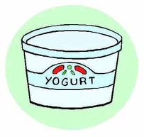
Objective solve problems involving the relative sizes of two quantities where missing values can be found by using integer multiplication and division facts solve problems involving the calculation of percentages [for example, of measures and such as 15% of 360] and the use of percentages for comparison solve problems involving similar shapes where the scale factor is known or can be found solve problems involving unequal sharing and grouping using knowledge of fractions and multiples
You can buy 3 pots of banana yoghurt for £2·40
How much will it cost to buy 12 pots of banana yoghurt?

Slide 3
Objective solve problems involving the relative sizes of two quantities where missing values can be found by using integer multiplication and division facts solve problems involving the calculation of percentages [for example, of measures and such as 15% of 360] and the use of percentages for comparison solve problems involving similar shapes where the scale factor is known or can be found solve problems involving unequal sharing and grouping using knowledge of fractions and multiples
A child’s bus ticket costs £3·70 and an adult bus ticket costs twice as much.
How much does an adult bus ticket cost?

Slide 4
Objective solve problems involving the relative sizes of two quantities where missing values can be found by using integer multiplication and division facts solve problems involving the calculation of percentages [for example, of measures and such as 15% of 360] and the use of percentages for comparison solve problems involving similar shapes where the scale factor is known or can be found solve problems involving unequal sharing and grouping using knowledge of fractions and multiples
A child’s bus ticket costs £3·70 and an adult bus ticket costs twice as much.
How much does it cost for 3 adults and 5 children?

Slide 5
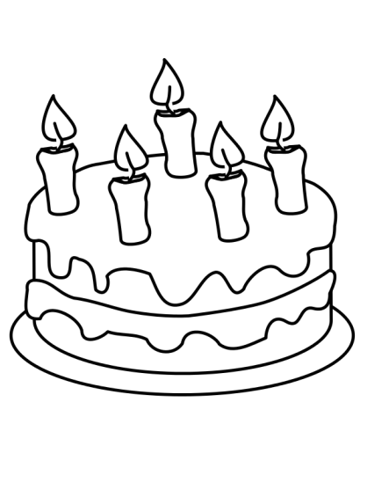
Objective solve problems involving the relative sizes of two quantities where missing values can be found by using integer multiplication and division facts solve problems involving the calculation of percentages [for example, of measures and such as 15% of 360] and the use of percentages for comparison solve problems involving similar shapes where the scale factor is known or can be found solve problems involving unequal sharing and grouping using knowledge of fractions and multiples
To make a sponge cake, I need six times as much flour as I do when I’m making a fairy cake.
If a sponge cake needs 270 g of flour, how much does a fairy cake need?

Slide 6
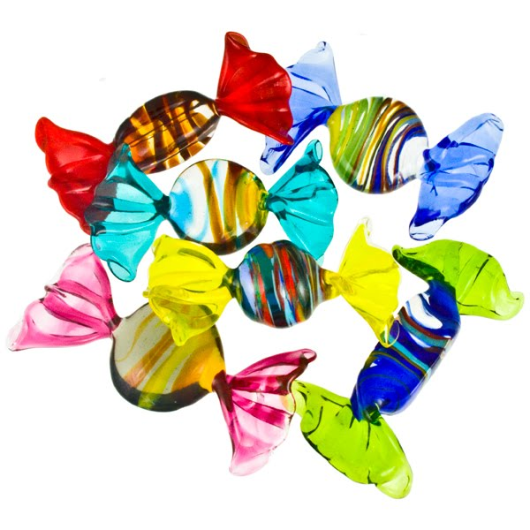
Objective solve problems involving the relative sizes of two quantities where missing values can be found by using integer multiplication and division facts solve problems involving the calculation of percentages [for example, of measures and such as 15% of 360] and the use of percentages for comparison solve problems involving similar shapes where the scale factor is known or can be found solve problems involving unequal sharing and grouping using knowledge of fractions and multiples
Sam has 9 fewer sweets than Sarah. They have 35 sweets altogether.
How many sweets does Sam have?

Slide 7
Objective solve problems involving the relative sizes of two quantities where missing values can be found by using integer multiplication and division facts solve problems involving the calculation of percentages [for example, of measures and such as 15% of 360] and the use of percentages for comparison solve problems involving similar shapes where the scale factor is known or can be found solve problems involving unequal sharing and grouping using knowledge of fractions and multiples
Sam has 19 fewer sweets than Sarah. They have 135 sweets altogether.
How many sweets does Sam have?

Slide 8
Objective solve problems involving the relative sizes of two quantities where missing values can be found by using integer multiplication and division facts solve problems involving the calculation of percentages [for example, of measures and such as 15% of 360] and the use of percentages for comparison solve problems involving similar shapes where the scale factor is known or can be found solve problems involving unequal sharing and grouping using knowledge of fractions and multiples
Mum is 28 years older than Anthony. Mum is 4 years younger than Dad. The total age of the three of them is 84 years.
What is Mum’s age?

Slide 9
Objective solve problems involving the relative sizes of two quantities where missing values can be found by using integer multiplication and division facts solve problems involving the calculation of percentages [for example, of measures and such as 15% of 360] and the use of percentages for comparison solve problems involving similar shapes where the scale factor is known or can be found solve problems involving unequal sharing and grouping using knowledge of fractions and multiples
If I share equally a 3 m ribbon between 5 people, how long will each person’s ribbon be?

Slide 10
Objective solve problems involving the relative sizes of two quantities where missing values can be found by using integer multiplication and division facts solve problems involving the calculation of percentages [for example, of measures and such as 15% of 360] and the use of percentages for comparison solve problems involving similar shapes where the scale factor is known or can be found solve problems involving unequal sharing and grouping using knowledge of fractions and multiples
In Year 1 there are 50 pupils, of whom 16 are boys.
What percentage of the pupils are girls?

Slide 11
Objective solve problems involving the relative sizes of two quantities where missing values can be found by using integer multiplication and division facts solve problems involving the calculation of percentages [for example, of measures and such as 15% of 360] and the use of percentages for comparison solve problems involving similar shapes where the scale factor is known or can be found solve problems involving unequal sharing and grouping using knowledge of fractions and multiples
In a class of children 25% are boys and the rest are girls. There are 18 girls.
How many children are in the class?

Slide 12
Objective solve problems involving the relative sizes of two quantities where missing values can be found by using integer multiplication and division facts solve problems involving the calculation of percentages [for example, of measures and such as 15% of 360] and the use of percentages for comparison solve problems involving similar shapes where the scale factor is known or can be found solve problems involving unequal sharing and grouping using knowledge of fractions and multiples
I share equally a length of ribbon between 8 people, and each person gets 0·25m of ribbon.
Can you work out how long the original piece of ribbon was?

Slide 13
Objective solve problems involving the relative sizes of two quantities where missing values can be found by using integer multiplication and division facts solve problems involving the calculation of percentages [for example, of measures and such as 15% of 360] and the use of percentages for comparison solve problems involving similar shapes where the scale factor is known or can be found solve problems involving unequal sharing and grouping using knowledge of fractions and multiples
Sam and Tom share 45 marbles in the ratio 2:3.
How many more marbles does Tom have than Sam?

Slide 14
Objective solve problems involving the relative sizes of two quantities where missing values can be found by using integer multiplication and division facts solve problems involving the calculation of percentages [for example, of measures and such as 15% of 360] and the use of percentages for comparison solve problems involving similar shapes where the scale factor is known or can be found solve problems involving unequal sharing and grouping using knowledge of fractions and multiples
To make a tomato pizza topping for a normal pizza, Jake uses 300 g of tomatoes, 120 g of onions and 75g of mushrooms. Jake wants enough sauce for a giant pizza, so he uses 900 g of tomatoes.
What mass of onions will be used?
How many 120 g boxes of mushrooms will he have to buy?

Slide 15
Objective solve problems involving the relative sizes of two quantities where missing values can be found by using integer multiplication and division facts solve problems involving the calculation of percentages [for example, of measures and such as 15% of 360] and the use of percentages for comparison solve problems involving similar shapes where the scale factor is known or can be found solve problems involving unequal sharing and grouping using knowledge of fractions and multiples
Jake has now made his giant pizza. He says, ‘I made three times as much sauce to cover the giant pizza as I do to cover a normal pizza, so the giant pizza is three times as big as the normal pizza.’
Do you agree with Jake? Why?

Slide 16
Objective solve problems involving the relative sizes of two quantities where missing values can be found by using integer multiplication and division facts solve problems involving the calculation of percentages [for example, of measures and such as 15% of 360] and the use of percentages for comparison solve problems involving similar shapes where the scale factor is known or can be found solve problems involving unequal sharing and grouping using knowledge of fractions and multiples
Harry and Jim share some marbles in the ratio 3:5.
Jim gets 24 more marbles than Harry does.
How many marbles did they share in total between them?

Slide 17
Objective generate and describe linear number sequences express missing number problems algebraically find pairs of numbers that satisfy an equation with two unknowns
Ramesh is exploring two sequence-generating rules.
Rule A is: ‘Start at 2, and then add on 5, and another 5, and another 5, and so on.’
Rule B is: ‘Write out the numbers that are in the five times table, and then subtract 2 from each number.’
What’s the same and what’s different about the sequences generated by these two rules?

Slide 18
Objective generate and describe linear number sequences express missing number problems algebraically find pairs of numbers that satisfy an equation with two unknowns
Ramesh is exploring three sequence-generating rules.
Rule A is: ‘Start at 30, and then add on 7, and another 7, and another 7, and so on.’
Rule B is: ‘Write out the numbers that are in the seven times table, and then add 2 to each number.’
Rule C is: ‘Start at 51, and then add on 4, and another 4, and another 4, and so on.’
What’s the same and what’s different about the sequences generated by these three rules?
Explain why any common patterns occur.

Slide 19
Objective generate and describe linear number sequences express missing number problems algebraically find pairs of numbers that satisfy an equation with two unknowns
Roshni and Darren are using sequence-generating rules.
Roshni’s rule is: ‘Start at 4, and then add on 5, and another 5, and another 5, and so on.’
Darren’s rule is: ‘Write out the numbers that are multiples of 5, starting with 5, and then subtract 1 from each number.’
Roshni and Darren notice that the first few numbers in the sequences generated by each of their rules are the same. They think that all the numbers in the sequences generated by each of their rules will be the same.
Do you agree? Explain your decision.

Slide 20
Objective generate and describe linear number sequences express missing number problems algebraically find pairs of numbers that satisfy an equation with two unknowns
Roshni and Darren are using sequence-generating rules.
Roshni’s rule is: ‘Start at 5, and then add on 9, and another 9, and another 9, and so on.’
Darren’s rule is: ‘Write out the numbers that are multiples of 3, starting with 3, and then subtract 1 from each number.’
What might Roshni and Darren notice about the numbers in the sequences generated by each of these rules?
Explain your reasoning.

Slide 21
Objective generate and describe linear number sequences express missing number problems algebraically find pairs of numbers that satisfy an equation with two unknowns
On New Year’s Eve, Polly has £3·50 in her money box. On 1 January she puts 30p into her money box. On 2 January she puts another 30p into her money box. She continues putting in 30p every day.
How much money is in the box on 10 January?
How much money is in the box on 10 February?
Write a sequence-generating rule for working out the amount of money in the money box on any day in January.

Slide 22
Objective generate and describe linear number sequences express missing number problems algebraically find pairs of numbers that satisfy an equation with two unknowns
On New Year’s Eve, Polly has £3·50 in her money box. On 1 January she puts 30p into her money box. On 2 January she puts another 30p into her money box. She continues putting in 30p every day.
On what date is there exactly £8 in Polly’s money box?
On what date does Polly’s money box first contain more than £15?
Write a sequence-generating rule for working out the amount of money in the money box on any day.

Slide 23
Objective generate and describe linear number sequences express missing number problems algebraically find pairs of numbers that satisfy an equation with two unknowns
Which of the following statements do you agree with? Explain your decisions.
The value 5 satisfies the symbol sentence
3 × __ + 2 = 17
The value 7 satisfies the symbol sentence
3 + __ × 2 = 10 + __
The value 6 solves the equation 20 – x = 10
The value 5 solves the equation 20 ÷ x = x – 1

Slide 24
Objective generate and describe linear number sequences express missing number problems algebraically find pairs of numbers that satisfy an equation with two unknowns
Which of the following statements do you agree with? Explain your decisions.
There is a whole number that satisfies the symbol sentence 5 × ___ – 3 = 42
There is a whole number that satisfies the symbol sentence 5 + ___ × 3 = 42
There is a whole number that solves the equation 10 – x = 4x
There is a whole number that solves the equation 20 ÷ x = x

Slide 25
Objective generate and describe linear number sequences express missing number problems algebraically find pairs of numbers that satisfy an equation with two unknowns
I am going to buy some 11p stamps and some 17p stamps.
I want to spend exactly 95p. Write this as a symbol sentence and find whole number values that satisfy your sentence.
Now tell me how many of each stamp I should buy.

Slide 26
Objective generate and describe linear number sequences express missing number problems algebraically find pairs of numbers that satisfy an equation with two unknowns
I want to spend exactly £1·95 . Write this as a symbol sentence and find whole number values that satisfy your sentence.
Now tell me how many of each stamp I should buy.

Slide 27
Objective generate and describe linear number sequences express missing number problems algebraically find pairs of numbers that satisfy an equation with two unknowns
I want to spend exactly £1·59 . Write this as a symbol number sentence.
Can you convince yourself that you can’t find whole number values that satisfy your symbol sentence?
Explain your reasoning.

Slide 28
Objective solve problems involving the calculation and conversion of units of measure, using decimal notation up to three decimal places where appropriate use, read, write and convert between standard units, converting measurements of length, mass, volume and time from a smaller unit of measure to a larger unit, and vice versa, using decimal notation to up to three decimal places recognise that shapes with the same areas can have different perimeters and vice versa calculate the area of parallelograms and triangles
Draw a clock face, then draw the hands showing that the time is 3 p.m.
Draw a second clock face, then draw the hands showing the time 12 000 seconds later.

Slide 29
Objective solve problems involving the calculation and conversion of units of measure, using decimal notation up to three decimal places where appropriate use, read, write and convert between standard units, converting measurements of length, mass, volume and time from a smaller unit of measure to a larger unit, and vice versa, using decimal notation to up to three decimal places recognise that shapes with the same areas can have different perimeters and vice versa calculate the area of parallelograms and triangles
Mehvish and Rima are looking at a clock face. They agree that at midday the hands of the clock lie on top of each other and so the angle between them is 0°.
Rima thinks that at 3:15 p.m. the angle between the hands will be 90°. Mehvish thinks that the angle will be less than 90°.
Do you agree with Rima or Mehvish?
Explain your decision.

Slide 30
Objective solve problems involving the calculation and conversion of units of measure, using decimal notation up to three decimal places where appropriate use, read, write and convert between standard units, converting measurements of length, mass, volume and time from a smaller unit of measure to a larger unit, and vice versa, using decimal notation to up to three decimal places recognise that shapes with the same areas can have different perimeters and vice versa calculate the area of parallelograms and triangles
Imagine we talked about time using decimals.
Would 2·3 hours be:
2 hours and 3 minutes
2 hours and 20 minutes
2 and a half hours, or
2 hours and 18 minutes?
Explain your decision.

Slide 31
Objective solve problems involving the calculation and conversion of units of measure, using decimal notation up to three decimal places where appropriate use, read, write and convert between standard units, converting measurements of length, mass, volume and time from a smaller unit of measure to a larger unit, and vice versa, using decimal notation to up to three decimal places recognise that shapes with the same areas can have different perimeters and vice versa calculate the area of parallelograms and triangles
Sarah is 0·2 m taller than Jack.
Ella is 15 cm taller than Sarah.
Their combined height is 3·25 m.
How tall is Ella?

Slide 32
Objective solve problems involving the calculation and conversion of units of measure, using decimal notation up to three decimal places where appropriate use, read, write and convert between standard units, converting measurements of length, mass, volume and time from a smaller unit of measure to a larger unit, and vice versa, using decimal notation to up to three decimal places recognise that shapes with the same areas can have different perimeters and vice versa calculate the area of parallelograms and triangles
Sarah is 0·2 m taller than Jack.
Ella is 15 cm taller than Sarah.
Who is the tallest person?
What is the difference in height between the tallest and the shortest person?

Slide 33
Objective solve problems involving the calculation and conversion of units of measure, using decimal notation up to three decimal places where appropriate use, read, write and convert between standard units, converting measurements of length, mass, volume and time from a smaller unit of measure to a larger unit, and vice versa, using decimal notation to up to three decimal places recognise that shapes with the same areas can have different perimeters and vice versa calculate the area of parallelograms and triangles
Think about these rectangles:
a 4 cm by 6 cm rectangle
a 12 cm by 2 cm rectangle
a 3 cm by 8 cm rectangle.
What’s the same? What’s different?

Slide 34
Objective solve problems involving the calculation and conversion of units of measure, using decimal notation up to three decimal places where appropriate use, read, write and convert between standard units, converting measurements of length, mass, volume and time from a smaller unit of measure to a larger unit, and vice versa, using decimal notation to up to three decimal places recognise that shapes with the same areas can have different perimeters and vice versa calculate the area of parallelograms and triangles
The diameter of a golf ball is 4 cm. I want to make a box which will hold six golf balls.
What size could my box be?
Is there more than one answer?

Slide 35
Objective solve problems involving the calculation and conversion of units of measure, using decimal notation up to three decimal places where appropriate use, read, write and convert between standard units, converting measurements of length, mass, volume and time from a smaller unit of measure to a larger unit, and vice versa, using decimal notation to up to three decimal places recognise that shapes with the same areas can have different perimeters and vice versa calculate the area of parallelograms and triangles
Can you find two or more different cuboids each with a volume of 64 cm3?
What’s the same and what’s different about your cuboids?

Slide 36
Objective solve problems involving the calculation and conversion of units of measure, using decimal notation up to three decimal places where appropriate use, read, write and convert between standard units, converting measurements of length, mass, volume and time from a smaller unit of measure to a larger unit, and vice versa, using decimal notation to up to three decimal places recognise that shapes with the same areas can have different perimeters and vice versa calculate the area of parallelograms and triangles
Linda says, ‘If you draw two rectangles and the second one has a greater perimeter than the first one, then the second one will also have a greater area.’
Do you agree or disagree with her?
Explain your reasoning.

Slide 37
Objective solve problems involving the calculation and conversion of units of measure, using decimal notation up to three decimal places where appropriate use, read, write and convert between standard units, converting measurements of length, mass, volume and time from a smaller unit of measure to a larger unit, and vice versa, using decimal notation to up to three decimal places recognise that shapes with the same areas can have different perimeters and vice versa calculate the area of parallelograms and triangles
10 toy bricks have a total mass of 1 kg.
A cricket ball weighs 112 times as much as one brick.
What is the mass of a cricket ball, in grams?

Slide 38
Objective draw 2-D shapes using given dimensions and angles recognise, describe and build simple 3-D shapes, including making nets compare and classify geometric shapes based on their properties and sizes and find unknown angles in any triangles, quadrilaterals, and regular polygons illustrate and name parts of circles, including radius, diameter and circumference and know that the diameter is twice the radius recognise angles where they meet at a point, are on a straight line, or are vertically opposite, and find missing angles describe positions on the full coordinate grid (all four quadrants) draw and translate simple shapes on the coordinate plane, and reflect them in the axes
Accurately draw two right-angled triangles with sides of different lengths.
Compare them and describe what’s the same and what’s different about them.

Slide 39
Objective draw 2-D shapes using given dimensions and angles recognise, describe and build simple 3-D shapes, including making nets compare and classify geometric shapes based on their properties and sizes and find unknown angles in any triangles, quadrilaterals, and regular polygons illustrate and name parts of circles, including radius, diameter and circumference and know that the diameter is twice the radius recognise angles where they meet at a point, are on a straight line, or are vertically opposite, and find missing angles describe positions on the full coordinate grid (all four quadrants) draw and translate simple shapes on the coordinate plane, and reflect them in the axes
A triangle has been drawn carefully. You are told that the biggest angle is 20° larger than the second biggest angle and 40° larger than the smallest angle.
Work out how big each angle is.

Slide 40
Objective draw 2-D shapes using given dimensions and angles recognise, describe and build simple 3-D shapes, including making nets compare and classify geometric shapes based on their properties and sizes and find unknown angles in any triangles, quadrilaterals, and regular polygons illustrate and name parts of circles, including radius, diameter and circumference and know that the diameter is twice the radius recognise angles where they meet at a point, are on a straight line, or are vertically opposite, and find missing angles describe positions on the full coordinate grid (all four quadrants) draw and translate simple shapes on the coordinate plane, and reflect them in the axes
An isosceles triangle has two vertices at
(–3,2) and (3,2).
Explore where the third vertex could be.

Slide 41
Objective draw 2-D shapes using given dimensions and angles recognise, describe and build simple 3-D shapes, including making nets compare and classify geometric shapes based on their properties and sizes and find unknown angles in any triangles, quadrilaterals, and regular polygons illustrate and name parts of circles, including radius, diameter and circumference and know that the diameter is twice the radius recognise angles where they meet at a point, are on a straight line, or are vertically opposite, and find missing angles describe positions on the full coordinate grid (all four quadrants) draw and translate simple shapes on the coordinate plane, and reflect them in the axes
A square has two vertices at (0,0) and (3,3).
Work out and explain the coordinates where the other two vertices could be.
A square has two vertices at (–3,0) and (3,0).
Work out and explain the coordinates where the other two vertices could be.

Slide 42
Objective draw 2-D shapes using given dimensions and angles recognise, describe and build simple 3-D shapes, including making nets compare and classify geometric shapes based on their properties and sizes and find unknown angles in any triangles, quadrilaterals, and regular polygons illustrate and name parts of circles, including radius, diameter and circumference and know that the diameter is twice the radius recognise angles where they meet at a point, are on a straight line, or are vertically opposite, and find missing angles describe positions on the full coordinate grid (all four quadrants) draw and translate simple shapes on the coordinate plane, and reflect them in the axes
Are these statements always, sometimes or never true?
If a shape is reflected in an axis, it stays in the same quadrant.
If a shape is translated to the right and up, it stays in the same quadrant.
If a shape is translated to the left and down, it stays in the same quadrant.
Explain your decisions.

Slide 43
Objective draw 2-D shapes using given dimensions and angles recognise, describe and build simple 3-D shapes, including making nets compare and classify geometric shapes based on their properties and sizes and find unknown angles in any triangles, quadrilaterals, and regular polygons illustrate and name parts of circles, including radius, diameter and circumference and know that the diameter is twice the radius recognise angles where they meet at a point, are on a straight line, or are vertically opposite, and find missing angles describe positions on the full coordinate grid (all four quadrants) draw and translate simple shapes on the coordinate plane, and reflect them in the axes
Joan says that if you reflect a shape (in an axis) and then reflect it again, the shape always ends up back where it first was as though you’d done nothing to it.
Do you agree with Joan?
Explain your decision.

Slide 44
Objective draw 2-D shapes using given dimensions and angles recognise, describe and build simple 3-D shapes, including making nets compare and classify geometric shapes based on their properties and sizes and find unknown angles in any triangles, quadrilaterals, and regular polygons illustrate and name parts of circles, including radius, diameter and circumference and know that the diameter is twice the radius recognise angles where they meet at a point, are on a straight line, or are vertically opposite, and find missing angles describe positions on the full coordinate grid (all four quadrants) draw and translate simple shapes on the coordinate plane, and reflect them in the axes
Compare a circle and an oval.
What’s the same and what’s different?
Use as much maths vocabulary as you know to explain your answer.

Slide 45
Objective draw 2-D shapes using given dimensions and angles recognise, describe and build simple 3-D shapes, including making nets compare and classify geometric shapes based on their properties and sizes and find unknown angles in any triangles, quadrilaterals, and regular polygons illustrate and name parts of circles, including radius, diameter and circumference and know that the diameter is twice the radius recognise angles where they meet at a point, are on a straight line, or are vertically opposite, and find missing angles describe positions on the full coordinate grid (all four quadrants) draw and translate simple shapes on the coordinate plane, and reflect them in the axes
Pascal says that any net made with six squares can be folded to make a cube.
Do you agree with him?
Explain your reasoning.

Slide 46
Objective interpret and construct pie charts and line graphs and use these to solve problems calculate and interpret the mean as an average
Three teams are taking part in the heats of a 4 × 100 m relay race competition on Sports Day. If the mean average time of the four runners in a team is less than 30 seconds, the team will be selected for the finals.
At the start of the last leg of the relay race, the times (in seconds) of each teams’ first three runners are:
Team Peacock: 27, 29, 31
Team Farah: 45, 43, 37
Team Ennis: 29, 30, 25
Which of the teams have the best chance of being selected?
Explain your reasoning.

Slide 47
Objective interpret and construct pie charts and line graphs and use these to solve problems calculate and interpret the mean as an average
Ten pupils take part in some races on Sports Day, and the following times are recorded.
Time to run 100 m (seconds): 23, 21, 21, 20, 21, 22, 24, 23, 22, 20.
Time to run 100 m holding an egg and spoon (seconds): 45, 47, 49, 43, 44, 46, 78,
46, 44, 48.
Time to run 100 m in a three-legged race (seconds): 50, 83, 79, 48, 53, 52, 85, 81,
49, 84.
Calculate the mean average of the times recorded in each race.
For each race, do you think that the mean average of the times would give a useful summary of the ten individual times?
Explain your decision.

Slide 48
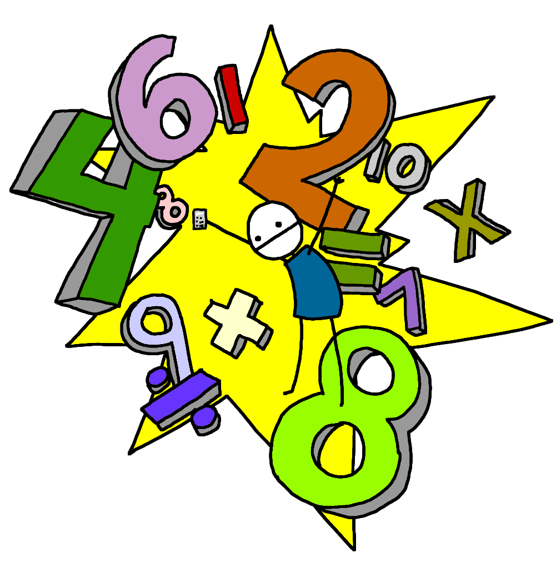
Objective read, write, order and compare numbers up to 10 000 000 and determine the value of each digit round any whole number to a required degree of accuracy use negative numbers in context, and calculate intervals across 0 solve number and practical problems that involve all of the above
Think about the number 34 567 800.
Say this number aloud.
Round this number to the nearest million.
What does the digit ‘8’ represent?
What does the digit ‘7’ represent?
Divide this number by 100 and say your answer aloud.
Divide this number by 1000 and say your answer aloud.

Slide 49
Objective read, write, order and compare numbers up to 10 000 000 and determine the value of each digit round any whole number to a required degree of accuracy use negative numbers in context, and calculate intervals across 0 solve number and practical problems that involve all of the above
Miss Nice, the teacher, has four cards. On each card is a number:
59 996 59 943 60 026 62 312
She gives one card to each pupil. The pupils look at their card and say a clue.
Anna says, ‘My number is 60 000 to the nearest 10 thousand.’
Bashir says, ‘My number has exactly 600 hundreds in it.’
Charis says, ‘My number is 59900 to the nearest hundred.’
David says, ‘My number is 60 000 to the nearest 10.’
Can you work out which card each pupil had? Explain your choices

Slide 50
Objective read, write, order and compare numbers up to 10 000 000 and determine the value of each digit round any whole number to a required degree of accuracy use negative numbers in context, and calculate intervals across 0 solve number and practical problems that involve all of the above
Put these numbers in order, from smallest to largest.
3·3, 3·03, 3·33, 3·303, 3·033
5834, 61·8 multiplied by 100, one tenth of 45813
0·034, 3·6 divided by 100, ten times 0·0033
–4·4, –4·44, –4·04, –4·404

Slide 51
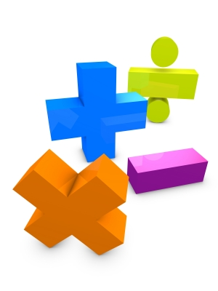
Objective read, write, order and compare numbers up to 10 000 000 and determine the value of each digit round any whole number to a required degree of accuracy use negative numbers in context, and calculate intervals across 0 solve number and practical problems that involve all of the above
Estimate the answer to 4243 + 1734 by rounding the numbers to:
the nearest 1000
the nearest 100
the nearest 50
the nearest 10.

Slide 52
Objective read, write, order and compare numbers up to 10 000 000 and determine the value of each digit round any whole number to a required degree of accuracy use negative numbers in context, and calculate intervals across 0 solve number and practical problems that involve all of the above
The population of Shanghai is 21 million, to the nearest million. Each person
weighs on average 70 kg.
Estimate the total weight of all the people in Shanghai.
Do you think your answer is more or less than the actual answer you’d get if you weighed everyone in Shanghai accurately? Why?

Slide 53
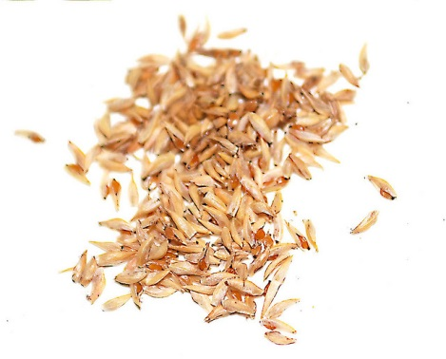
Objective read, write, order and compare numbers up to 10 000 000 and determine the value of each digit round any whole number to a required degree of accuracy use negative numbers in context, and calculate intervals across 0 solve number and practical problems that involve all of the above
The total population of Shanghai is 21 million, to the nearest million.
If at lunchtime everyone in Shanghai eats a bowl of rice, how many grains of rice do you estimate are eaten each lunchtime?
How much will this cost if each grain is worth 0.02 pence?

Slide 54
Objective read, write, order and compare numbers up to 10 000 000 and determine the value of each digit round any whole number to a required degree of accuracy use negative numbers in context, and calculate intervals across 0 solve number and practical problems that involve all of the above
The population of Shanghai is 21 million, to the nearest million. Each person
weighs on average 70 kg.
Estimate the total weight of all the people in Shanghai.
Do you think your answer is more or less than the actual answer you’d get if you weighed everyone in Shanghai accurately? Why?

Slide 55
Objective read, write, order and compare numbers up to 10 000 000 and determine the value of each digit round any whole number to a required degree of accuracy use negative numbers in context, and calculate intervals across 0 solve number and practical problems that involve all of the above
Three pupils are asked to estimate the answer to the sum 4243 + 1734.
Andrew says, ‘To the nearest 100, the answer will be 5900.’
Bilal says, ‘To the nearest 50, the answer will be 6000.’
Cheng says, ‘To the nearest 10, the answer will be 5970.’
Do you agree with Andrew, Bilal or Cheng?
Can you explain their reasoning?

Slide 56
Objective read, write, order and compare numbers up to 10 000 000 and determine the value of each digit round any whole number to a required degree of accuracy use negative numbers in context, and calculate intervals across 0 solve number and practical problems that involve all of the above
Eduardo says, ‘The population of Mexico City is 11 million (to the nearest million) and the population of New York is 11·2 million (to the nearest hundred thousand).’
He says, ‘The population of New York must be bigger than the population of
Mexico City because 11·2 million is bigger than 11 million.’
Do you agree with him? Explain your reasoning.

Slide 57
Objective read, write, order and compare numbers up to 10 000 000 and determine the value of each digit round any whole number to a required degree of accuracy use negative numbers in context, and calculate intervals across 0 solve number and practical problems that involve all of the above
A scientist measured the temperature each day
for one week at 06:00.
On Sunday the temperature was 1·6°C.
On Monday the temperature had fallen by 3°C.
On Tuesday the temperature had fallen by 2·1°C.
On Wednesday the temperature had risen by 1·6°C.
On Thursday the temperature had risen by 4·2°C.
On Friday the temperature had fallen by 0·9°C.
On Saturday the temperature had risen by 0·2°C.
What was the temperature on Saturday?

Slide 58
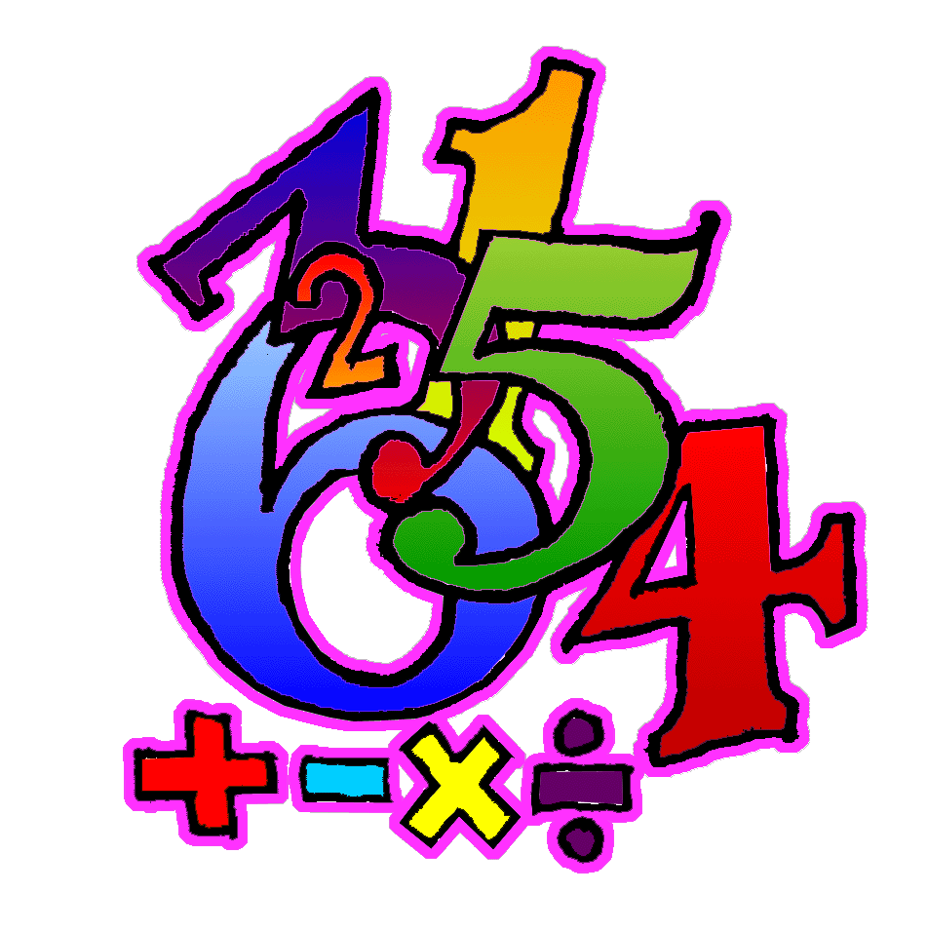
Objective solve addition and subtraction multi-step problems in contexts, deciding which operations and methods to use and why use estimation to check answers to calculations and determine, in the context of a problem, an appropriate degree of accuracy
Calculate 36·2 + 19·8
with a formal written column method
with a mental method, explaining your reasoning.

Slide 59
Objective solve addition and subtraction multi-step problems in contexts, deciding which operations and methods to use and why use estimation to check answers to calculations and determine, in the context of a problem, an appropriate degree of accuracy
Jasmine and Kamal have been asked to work out 5748 + 893 and 5748 – 893.
Jasmine says, ‘893 is 7 less than 900, and 900 is 100 less than 1000, so I can work out the addition by adding on 1000 and then taking away 100 and then taking away 7.’
What answer does Jasmine get, and is she correct?

Slide 60
Objective solve addition and subtraction multi-step problems in contexts, deciding which operations and methods to use and why use estimation to check answers to calculations and determine, in the context of a problem, an appropriate degree of accuracy
Kamal says, ‘893 is 7 less than 900, and 900 is 100 less than 1000, so I can work out the subtraction by taking away 1000 and then taking away 100 and then taking away 7.’
What answer does Kamal get, and is he correct?
If you disagree with either Jasmine or Kamal, can you correct their reasoning?

Slide 61
Objective solve addition and subtraction multi-step problems in contexts, deciding which operations and methods to use and why use estimation to check answers to calculations and determine, in the context of a problem, an appropriate degree of accuracy
Choose digits to go in the empty gaps to make these number sentences true.
14 781 – 6 __ 53 = 8528
23·12 + 22· __ = 45·23

Slide 62
Objective solve addition and subtraction multi-step problems in contexts, deciding which operations and methods to use and why use estimation to check answers to calculations and determine, in the context of a problem, an appropriate degree of accuracy
Two numbers have a difference of 2·38 . The smaller number is 3·12 .
What is the bigger number?
Two numbers have a difference of 2·3 . They are both less than 10.
What could the numbers be?

Slide 63
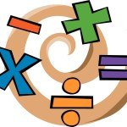
Objective solve addition and subtraction multi-step problems in contexts, deciding which operations and methods to use and why use estimation to check answers to calculations and determine, in the context of a problem, an appropriate degree of accuracy
Compare 31 + 9 × 7 and (31 + 9) × 7
What’s the same? What’s different?

Slide 64
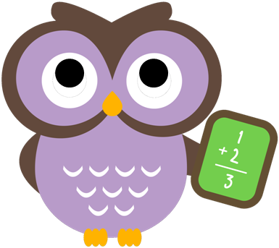
Objective solve addition and subtraction multi-step problems in contexts, deciding which operations and methods to use and why use estimation to check answers to calculations and determine, in the context of a problem, an appropriate degree of accuracy
Choose operations to go in the empty gaps to make these number sentences true.
6 __ 3 __ 7 = 16
6 __ 3 __ 7 = 27
6 __ 3 __ 7 = 9

Slide 65
Objective solve addition and subtraction multi-step problems in contexts, deciding which operations and methods to use and why use estimation to check answers to calculations and determine, in the context of a problem, an appropriate degree of accuracy
Put brackets in these number sentences so that they are true.
12 – 2 × 5 = 50
12 – 8 – 5 = 9
10 × 8 – 3 × 5 = 250

Slide 66
Objective solve addition and subtraction multi-step problems in contexts, deciding which operations and methods to use and why use estimation to check answers to calculations and determine, in the context of a problem, an appropriate degree of accuracy
Can you write a number sentence using the digits 2, 3, 5 and 8 before the equals sign, which has the same answer as another number sentence using the digits 2, 3, 5 and 8 but which is a different sentence?

Slide 67
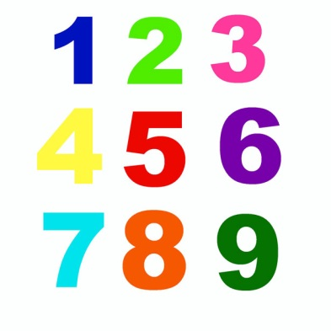
Objective solve addition and subtraction multi-step problems in contexts, deciding which operations and methods to use and why use estimation to check answers to calculations and determine, in the context of a problem, an appropriate degree of accuracy
Write different number sentences using the digits 2, 3, 5 and 8 before the equals sign, using:
one operation
two operations but no brackets
two operations and brackets.

Slide 68
Objective solve addition and subtraction multi-step problems in contexts, deciding which operations and methods to use and why use estimation to check answers to calculations and determine, in the context of a problem, an appropriate degree of accuracy
Two numbers have a difference of 2·38 . What could the numbers be if:
the two numbers add up to 6?
one of the numbers is three times as big as the other number?
Two numbers have a difference of 2·3 . To the nearest 10, they are both 10.
What could the numbers be?

Slide 69
Objective solve addition and subtraction multi-step problems in contexts, deciding which operations and methods to use and why use estimation to check answers to calculations and determine, in the context of a problem, an appropriate degree of accuracy
Can you use five of the digits 1 to 9 to make this number sentence true?
__ __ · __ + __· __ = 31·7
Can you find other sets of five of the digits 1 to 9 that make the sentence true?

Slide 70
Objective solve addition and subtraction multi-step problems in contexts, deciding which operations and methods to use and why use estimation to check answers to calculations and determine, in the context of a problem, an appropriate degree of accuracy
A shop sells magazines and comics. Freya buys a magazine and a comic. She pays £2·50 . Evie buys a magazine and two comics. She pays £3·90.
How much does a comic cost? How much does a magazine cost?

Slide 71
Objective solve addition and subtraction multi-step problems in contexts, deciding which operations and methods to use and why use estimation to check answers to calculations and determine, in the context of a problem, an appropriate degree of accuracy
A shop sells boxes of chocolates. One box costs £3·99. A second box costs £2·60. A third box costs £6·45 .
What is the difference in price between the most and least expensive boxes?
The shop also sells packets of sweets. One packet costs £1·39 . Ramesh has a £10 note and he wants to buy the chocolates costing £2·60 .
How many packets of sweets can he also buy?

Slide 72
Objective solve addition and subtraction multi-step problems in contexts, deciding which operations and methods to use and why use estimation to check answers to calculations and determine, in the context of a problem, an appropriate degree of accuracy
A shop sells magazines and comics. Last week Arthur bought a magazine and a comic. He can’t remember exactly what he paid, but he thinks he paid £1·76 .
Yesterday he bought a magazine and four comics. He paid £4·30 .
Do you think he is remembering correctly when he says that he paid £1·76 last week?

Slide 73
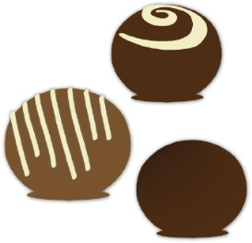
Objective solve addition and subtraction multi-step problems in contexts, deciding which operations and methods to use and why use estimation to check answers to calculations and determine, in the context of a problem, an appropriate degree of accuracy
A shop sells boxes of chocolates costing £2·60 . The shop also sells packets of sweets. One packet costs £1·39 . Ramesh has a £10 note and he wants to buy one box of chocolates.
Sara says that Ramesh can work out how many packets of sweets he can buy using the number sentence 10 – 2·60 ÷ 1·39 .
Do you agree or disagree with Sara?
If you disagree, what number sentence do you think Ramesh should use?
Explain your reasoning.

Slide 74
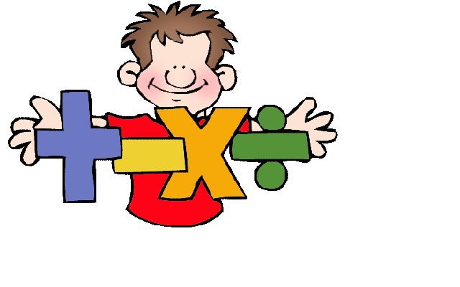
Objective solve addition and subtraction multi-step problems in contexts, deciding which operations and methods to use and why use estimation to check answers to calculations and determine, in the context of a problem, an appropriate degree of accuracy
x and y represent whole numbers.
Their sum is 1000.
x is 250 more than y.
What are the values of x and y?

Slide 75
Objective solve addition and subtraction multi-step problems in contexts, deciding which operations and methods to use and why use estimation to check answers to calculations and determine, in the context of a problem, an appropriate degree of accuracy
x and y represent whole numbers. Their sum is 1000.
Can the difference between x and y be:
100?
any whole number?
greater than x?
Why?

Slide 76
Objective multiply multi-digit numbers up to four digits by a 2-digit whole number using the formal written method of long multiplication divide numbers up to four digits by a 2-digit whole number using the formal written method of long division, and interpret remainders as whole number remainders, fractions, or by rounding, as appropriate for the context divide numbers up to four digits by a 2-digit number using the formal written method of short division where appropriate, interpreting remainders according to the context use their knowledge of the order of operations to carry out calculations involving the four operations solve problems involving addition, subtraction, multiplication and division multiply 1-digit numbers with up to two decimal places by whole numbers
Work out:
8·4 × 3 + 8·4 × 7
6·7 × 5 – 0·67 × 50
93 × 0·2 + 0·8 × 93
7·2 × 4 + 3·6 × 8

Slide 77
Objective multiply multi-digit numbers up to four digits by a 2-digit whole number using the formal written method of long multiplication divide numbers up to four digits by a 2-digit whole number using the formal written method of long division, and interpret remainders as whole number remainders, fractions, or by rounding, as appropriate for the context divide numbers up to four digits by a 2-digit number using the formal written method of short division where appropriate, interpreting remainders according to the context use their knowledge of the order of operations to carry out calculations involving the four operations solve problems involving addition, subtraction, multiplication and division multiply 1-digit numbers with up to two decimal places by whole numbers
All the pupils in a school were asked to choose between an adventure park and the seaside for a school trip. They voted, and the result was a ratio of 5:3 in favour of the adventure park. 125 children voted in favour of going to the adventure park.
How many children voted in favour of going to the seaside?

Slide 78
Objective multiply multi-digit numbers up to four digits by a 2-digit whole number using the formal written method of long multiplication divide numbers up to four digits by a 2-digit whole number using the formal written method of long division, and interpret remainders as whole number remainders, fractions, or by rounding, as appropriate for the context divide numbers up to four digits by a 2-digit number using the formal written method of short division where appropriate, interpreting remainders according to the context use their knowledge of the order of operations to carry out calculations involving the four operations solve problems involving addition, subtraction, multiplication and division multiply 1-digit numbers with up to two decimal places by whole numbers
All the pupils in a school were asked to choose between an art gallery and a science museum for a school trip. The result was a ratio of 12:7 in favour of the science museum. Five pupils were off school and didn’t vote. Every pupil went on the trip to the science museum the following week. After the trip there is a news headline on the school website that says ‘All 700 pupils in the school went to the science museum.’
Do you think that this news headline is correct? Explain your reasoning.

Slide 79
Objective multiply multi-digit numbers up to four digits by a 2-digit whole number using the formal written method of long multiplication divide numbers up to four digits by a 2-digit whole number using the formal written method of long division, and interpret remainders as whole number remainders, fractions, or by rounding, as appropriate for the context divide numbers up to four digits by a 2-digit number using the formal written method of short division where appropriate, interpreting remainders according to the context use their knowledge of the order of operations to carry out calculations involving the four operations solve problems involving addition, subtraction, multiplication and division multiply 1-digit numbers with up to two decimal places by whole numbers
In each pair of calculations, which one would you prefer to work out?
(a) 35 × 0·3 + 35 × 0·7 or (b) 3·5 × 0·3 + 35 × 7
(c) 6·4 × 1·27 – 64 × 0·1 or (d) 6·4 × 1·27 – 64 × 0·027
(e) 52·4 ÷ 0·7 + 524 ÷ 7 or (f ) 52·4 ÷ 0·7 – 524 ÷ 7
(g) 31·2 ÷ 3 – 2·4 ÷ 6 or (h) 31·2 ÷ 3 – 1·2 ÷ 0·3
Explain your choices and work them out!

Slide 80
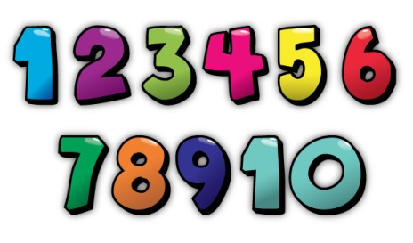
Objective multiply multi-digit numbers up to four digits by a 2-digit whole number using the formal written method of long multiplication divide numbers up to four digits by a 2-digit whole number using the formal written method of long division, and interpret remainders as whole number remainders, fractions, or by rounding, as appropriate for the context divide numbers up to four digits by a 2-digit number using the formal written method of short division where appropriate, interpreting remainders according to the context use their knowledge of the order of operations to carry out calculations involving the four operations solve problems involving addition, subtraction, multiplication and division multiply 1-digit numbers with up to two decimal places by whole numbers
Which calculation is the odd one out?
753 × 1·8
(75·3 × 3) × 6
753 + 753 ÷ 5 × 4
7·53 × 1800
753 × 2 – 753 × 0·2
750 × 1·8 + 3 × 1·8
Explain your reasoning.

Slide 81
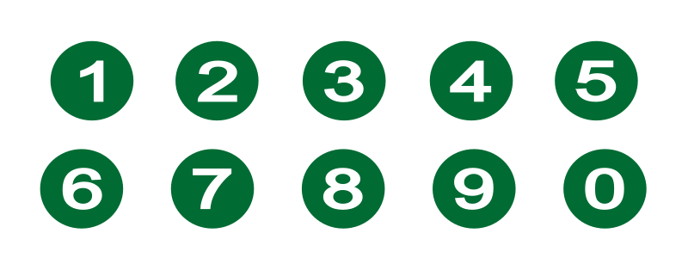
Objective multiply multi-digit numbers up to four digits by a 2-digit whole number using the formal written method of long multiplication divide numbers up to four digits by a 2-digit whole number using the formal written method of long division, and interpret remainders as whole number remainders, fractions, or by rounding, as appropriate for the context divide numbers up to four digits by a 2-digit number using the formal written method of short division where appropriate, interpreting remainders according to the context use their knowledge of the order of operations to carry out calculations involving the four operations solve problems involving addition, subtraction, multiplication and division multiply 1-digit numbers with up to two decimal places by whole numbers
It is correct that 273 × 32 = 8736. Use this fact to work out:
27·3 × 3·2
2·73 × 32 000
873·6 ÷ 0·32
87·36 ÷ 27·3
8736 ÷ 16
4368 ÷ 1·6

Slide 82
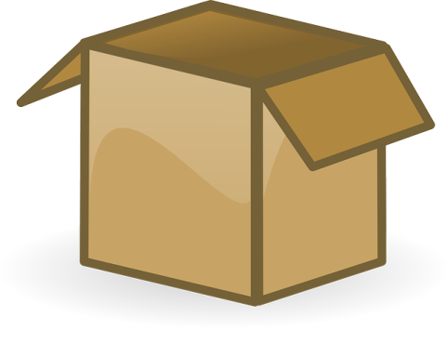
Objective multiply multi-digit numbers up to four digits by a 2-digit whole number using the formal written method of long multiplication divide numbers up to four digits by a 2-digit whole number using the formal written method of long division, and interpret remainders as whole number remainders, fractions, or by rounding, as appropriate for the context divide numbers up to four digits by a 2-digit number using the formal written method of short division where appropriate, interpreting remainders according to the context use their knowledge of the order of operations to carry out calculations involving the four operations solve problems involving addition, subtraction, multiplication and division multiply 1-digit numbers with up to two decimal places by whole numbers
A box of labels costs £24.
There are 100 sheets in the box.
There are 10 labels on each sheet.
Calculate the cost of one label, in pence.

Slide 83
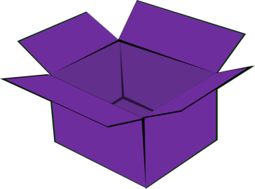
Objective multiply multi-digit numbers up to four digits by a 2-digit whole number using the formal written method of long multiplication divide numbers up to four digits by a 2-digit whole number using the formal written method of long division, and interpret remainders as whole number remainders, fractions, or by rounding, as appropriate for the context divide numbers up to four digits by a 2-digit number using the formal written method of short division where appropriate, interpreting remainders according to the context use their knowledge of the order of operations to carry out calculations involving the four operations solve problems involving addition, subtraction, multiplication and division multiply 1-digit numbers with up to two decimal places by whole numbers
A box of labels costs £63.
There are 140 sheets in the box.
There are 15 labels on each sheet.
Sara, Ramesh and Trevor want to calculate the cost of one label, in pence.
Ramesh uses the number sentence (6300 ÷ 140) × 15.
Sara uses the number sentence 63 ÷ 1·4 ÷ 15.
Trevor uses the number sentence (15 × 140) ÷ 6300.
Who is using the right number sentence? Explain your choice.

Slide 84
Objective multiply multi-digit numbers up to four digits by a 2-digit whole number using the formal written method of long multiplication divide numbers up to four digits by a 2-digit whole number using the formal written method of long division, and interpret remainders as whole number remainders, fractions, or by rounding, as appropriate for the context divide numbers up to four digits by a 2-digit number using the formal written method of short division where appropriate, interpreting remainders according to the context use their knowledge of the order of operations to carry out calculations involving the four operations solve problems involving addition, subtraction, multiplication and division multiply 1-digit numbers with up to two decimal places by whole numbers
Miriam and Alan each buy 12 tins of tomatoes.
Miriam buys 3 packs each containing 4 tins. A pack of 4 costs £1·40 .
Alan buys 2 packs each containing 6 cans. A pack of 6 costs £1·90 .
Who gets the most change from a £5 note?

Slide 85
Objective multiply multi-digit numbers up to four digits by a 2-digit whole number using the formal written method of long multiplication divide numbers up to four digits by a 2-digit whole number using the formal written method of long division, and interpret remainders as whole number remainders, fractions, or by rounding, as appropriate for the context divide numbers up to four digits by a 2-digit number using the formal written method of short division where appropriate, interpreting remainders according to the context use their knowledge of the order of operations to carry out calculations involving the four operations solve problems involving addition, subtraction, multiplication and division multiply 1-digit numbers with up to two decimal places by whole numbers
Miriam buys 19 tins of soup. All the tins cost the same price. She goes to the shop with just one note, and comes home with the tins and the change in coins. On the way home she drops the change. She looks carefully and she thinks she picks it all up. When she gets home she gives £2·23 change to her mother.
Do you think that Miriam picked up all the change that she dropped?
Explain your reasoning.

Slide 86
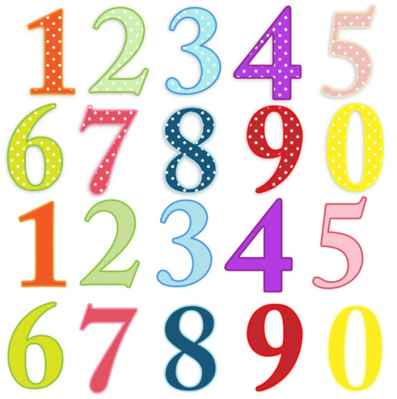
Objective multiply multi-digit numbers up to four digits by a 2-digit whole number using the formal written method of long multiplication divide numbers up to four digits by a 2-digit whole number using the formal written method of long division, and interpret remainders as whole number remainders, fractions, or by rounding, as appropriate for the context divide numbers up to four digits by a 2-digit number using the formal written method of short division where appropriate, interpreting remainders according to the context use their knowledge of the order of operations to carry out calculations involving the four operations solve problems involving addition, subtraction, multiplication and division multiply 1-digit numbers with up to two decimal places by whole numbers
Work out:
8·4 × 3 + 8·4 × 7
6·7 × 5 – 0·67 × 50
93 × 0·2 + 0·8 × 93
7·2 × 4 + 3·6 × 8

Slide 87
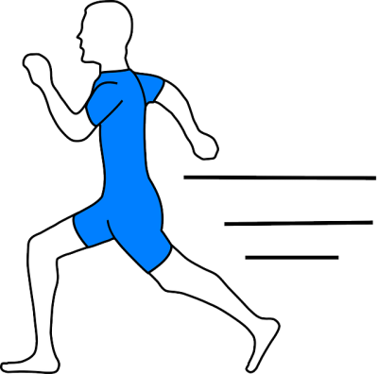
Objective use factors to simplify fractions; use common multiples to express fractions in the same denominator compare and order fractions, including fractions > 1 add and subtract fractions with different denominators and mixed numbers, using the concept of equivalent fractions multiply simple pairs of proper fractions, writing the answer in its simplest form [for example,1 /4 × 1 /2 = 1/ 8 ] divide proper fractions by whole numbers [for example, 1 / 3 ÷ 2 = 1 / 6 ] multiply 1-digit numbers with up to two decimal places by whole numbers and use equivalences between simple fractions, decimals and percentages, including in different contexts
On Monday I ran 1 2/3 km and on Tuesday I ran 2 2/5 km.
How far did I run altogether on these two days?
On Wednesday I ran 1 2/3 km and my
sister ran 2 2/5 km.
How much further did my sister run than I did?

Slide 88
Objective use factors to simplify fractions; use common multiples to express fractions in the same denominator compare and order fractions, including fractions > 1 add and subtract fractions with different denominators and mixed numbers, using the concept of equivalent fractions multiply simple pairs of proper fractions, writing the answer in its simplest form [for example,1 /4 × 1 /2 = 1/ 8 ] divide proper fractions by whole numbers [for example, 1 / 3 ÷ 2 = 1 / 6 ] multiply 1-digit numbers with up to two decimal places by whole numbers and use equivalences between simple fractions, decimals and percentages, including in different contexts
Altogether on Monday and Tuesday I ran 3 1/2 km. On neither day did I run a whole number of km.
Suggest how far I ran on Monday and how far on Tuesday.
On Wednesday I ran some km and my sister ran 1 1/6 km further than I did. Altogether we ran 4 1/2 km.
How far did I run on Wednesday?

Slide 89
Objective use factors to simplify fractions; use common multiples to express fractions in the same denominator compare and order fractions, including fractions > 1 add and subtract fractions with different denominators and mixed numbers, using the concept of equivalent fractions multiply simple pairs of proper fractions, writing the answer in its simplest form [for example,1 /4 × 1 /2 = 1/ 8 ] divide proper fractions by whole numbers [for example, 1 / 3 ÷ 2 = 1 / 6 ] multiply 1-digit numbers with up to two decimal places by whole numbers and use equivalences between simple fractions, decimals and percentages, including in different contexts
Sam added two fractions together and got 7/8 as the answer.
Write down two fractions that Sam could have added.

Slide 90
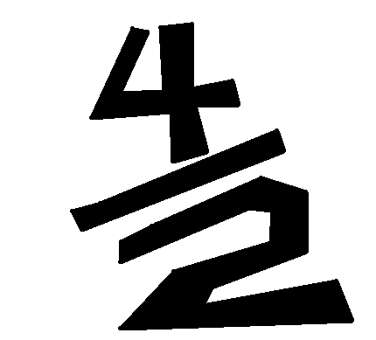
Objective use factors to simplify fractions; use common multiples to express fractions in the same denominator compare and order fractions, including fractions > 1 add and subtract fractions with different denominators and mixed numbers, using the concept of equivalent fractions multiply simple pairs of proper fractions, writing the answer in its simplest form [for example,1 /4 × 1 /2 = 1/ 8 ] divide proper fractions by whole numbers [for example, 1 / 3 ÷ 2 = 1 / 6 ] multiply 1-digit numbers with up to two decimal places by whole numbers and use equivalences between simple fractions, decimals and percentages, including in different contexts
Tom wrote down two fractions. He subtracted the smaller fraction from the larger and got 1/5 as the answer.
Write down two fractions that Tom could have subtracted.

Slide 91
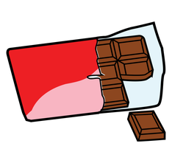
Objective use factors to simplify fractions; use common multiples to express fractions in the same denominator compare and order fractions, including fractions > 1 add and subtract fractions with different denominators and mixed numbers, using the concept of equivalent fractions multiply simple pairs of proper fractions, writing the answer in its simplest form [for example,1 /4 × 1 /2 = 1/ 8 ] divide proper fractions by whole numbers [for example, 1 / 3 ÷ 2 = 1 / 6 ] multiply 1-digit numbers with up to two decimal places by whole numbers and use equivalences between simple fractions, decimals and percentages, including in different contexts
Tom and Sam shared equally one third of a chocolate bar.
What fraction of the chocolate bar did each child get?

Slide 92
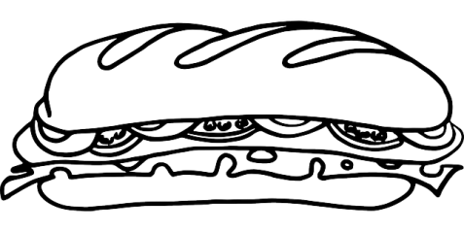
Objective use factors to simplify fractions; use common multiples to express fractions in the same denominator compare and order fractions, including fractions > 1 add and subtract fractions with different denominators and mixed numbers, using the concept of equivalent fractions multiply simple pairs of proper fractions, writing the answer in its simplest form [for example,1 /4 × 1 /2 = 1/ 8 ] divide proper fractions by whole numbers [for example, 1 / 3 ÷ 2 = 1 / 6 ] multiply 1-digit numbers with up to two decimal places by whole numbers and use equivalences between simple fractions, decimals and percentages, including in different contexts
Roland cuts a sandwich into two pieces. First, Roland gives one piece to Ayat and the other piece to Claire. Then Claire gives Ayat half of her piece. Now Ayat has 7/8 of the original sandwich.
Did Roland cut the sandwich into two equal pieces? If not, how did he cut the sandwich?

Slide 93
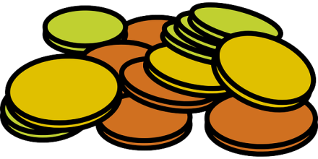
Objective use factors to simplify fractions; use common multiples to express fractions in the same denominator compare and order fractions, including fractions > 1 add and subtract fractions with different denominators and mixed numbers, using the concept of equivalent fractions multiply simple pairs of proper fractions, writing the answer in its simplest form [for example,1 /4 × 1 /2 = 1/ 8 ] divide proper fractions by whole numbers [for example, 1 / 3 ÷ 2 = 1 / 6 ] multiply 1-digit numbers with up to two decimal places by whole numbers and use equivalences between simple fractions, decimals and percentages, including in different contexts
Jakob says to Peter, ‘Last month I saved 0.5 of my pocket money and this month I saved 1/3 of my pocket money, so altogether I’ve saved 40% of my pocket money’.
Do you think Peter should agree with Jakob?
Explain your decision.

Slide 94
Objective use factors to simplify fractions; use common multiples to express fractions in the same denominator compare and order fractions, including fractions > 1 add and subtract fractions with different denominators and mixed numbers, using the concept of equivalent fractions multiply simple pairs of proper fractions, writing the answer in its simplest form [for example,1 /4 × 1 /2 = 1/ 8 ] divide proper fractions by whole numbers [for example, 1 / 3 ÷ 2 = 1 / 6 ] multiply 1-digit numbers with up to two decimal places by whole numbers and use equivalences between simple fractions, decimals and percentages, including in different contexts
Last month Kira saved 3 5 of her £10 pocket money. She also saved 15% of her £20 birthday money.
How much did she save altogether?

Slide 95
Objective use factors to simplify fractions; use common multiples to express fractions in the same denominator compare and order fractions, including fractions > 1 add and subtract fractions with different denominators and mixed numbers, using the concept of equivalent fractions multiply simple pairs of proper fractions, writing the answer in its simplest form [for example,1 /4 × 1 /2 = 1/ 8 ] divide proper fractions by whole numbers [for example, 1 / 3 ÷ 2 = 1 / 6 ] multiply 1-digit numbers with up to two decimal places by whole numbers and use equivalences between simple fractions, decimals and percentages, including in different contexts
Amira says, ‘To work out a fraction of a number, you multiply the number by the numerator of the fraction and then divide the answer by the denominator of the fraction.’
Do you think that this is always, sometimes or never true?
Explain your reasoning.

Slide 96
Objective use factors to simplify fractions; use common multiples to express fractions in the same denominator compare and order fractions, including fractions > 1 add and subtract fractions with different denominators and mixed numbers, using the concept of equivalent fractions multiply simple pairs of proper fractions, writing the answer in its simplest form [for example,1 /4 × 1 /2 = 1/ 8 ] divide proper fractions by whole numbers [for example, 1 / 3 ÷ 2 = 1 / 6 ] multiply 1-digit numbers with up to two decimal places by whole numbers and use equivalences between simple fractions, decimals and percentages, including in different contexts
What’s the same, and what’s different about these number statements?
Double one third of 15
One third of 30
2 × 5
15 × 2 ÷ 3
15 ÷ 3 × 2

Slide 97
Objective use factors to simplify fractions; use common multiples to express fractions in the same denominator compare and order fractions, including fractions > 1 add and subtract fractions with different denominators and mixed numbers, using the concept of equivalent fractions multiply simple pairs of proper fractions, writing the answer in its simplest form [for example,1 /4 × 1 /2 = 1/ 8 ] divide proper fractions by whole numbers [for example, 1 / 3 ÷ 2 = 1 / 6 ] multiply 1-digit numbers with up to two decimal places by whole numbers and use equivalences between simple fractions, decimals and percentages, including in different contexts
True or false?
The sum of two fractions is always greater than their product.
If I divide a fraction by a whole number, the quotient is always smaller than the dividend.
Explain your reasoning.

Slide 98
Objective use factors to simplify fractions; use common multiples to express fractions in the same denominator compare and order fractions, including fractions > 1 add and subtract fractions with different denominators and mixed numbers, using the concept of equivalent fractions multiply simple pairs of proper fractions, writing the answer in its simplest form [for example,1 /4 × 1 /2 = 1/ 8 ] divide proper fractions by whole numbers [for example, 1 / 3 ÷ 2 = 1 / 6 ] multiply 1-digit numbers with up to two decimal places by whole numbers and use equivalences between simple fractions, decimals and percentages, including in different contexts
Curtis used 1/3 of a can of paint to cover 3·5 square metres of wall.
How much wall will one whole can of paint cover?

Slide 99
Objective use factors to simplify fractions; use common multiples to express fractions in the same denominator compare and order fractions, including fractions > 1 add and subtract fractions with different denominators and mixed numbers, using the concept of equivalent fractions multiply simple pairs of proper fractions, writing the answer in its simplest form [for example,1 /4 × 1 /2 = 1/ 8 ] divide proper fractions by whole numbers [for example, 1 / 3 ÷ 2 = 1 / 6 ] multiply 1-digit numbers with up to two decimal places by whole numbers and use equivalences between simple fractions, decimals and percentages, including in different contexts
Puja shares 6 apples between some friends. Each friend gets 0·75 of an apple.
How many friends does she share the apples with?

Slide 100
Objective use factors to simplify fractions; use common multiples to express fractions in the same denominator compare and order fractions, including fractions > 1 add and subtract fractions with different denominators and mixed numbers, using the concept of equivalent fractions multiply simple pairs of proper fractions, writing the answer in its simplest form [for example,1 /4 × 1 /2 = 1/ 8 ] divide proper fractions by whole numbers [for example, 1 / 3 ÷ 2 = 1 / 6 ] multiply 1-digit numbers with up to two decimal places by whole numbers and use equivalences between simple fractions, decimals and percentages, including in different contexts
Puja shares 15 apples between some friends. Each friend gets 0·25 of an apple.
How many friends does she share the apples with?

Slide 101
Objective use factors to simplify fractions; use common multiples to express fractions in the same denominator compare and order fractions, including fractions > 1 add and subtract fractions with different denominators and mixed numbers, using the concept of equivalent fractions multiply simple pairs of proper fractions, writing the answer in its simplest form [for example,1 /4 × 1 /2 = 1/ 8 ] divide proper fractions by whole numbers [for example, 1 / 3 ÷ 2 = 1 / 6 ] multiply 1-digit numbers with up to two decimal places by whole numbers and use equivalences between simple fractions, decimals and percentages, including in different contexts
Puja shares 32 apples between some friends. Each friend gets 1/3 of an apple.
How many friends does she share the apples with?

